Slide 1

SEBI
Presentation by
Foundation of Independent Financial Advisors
10 March 2023

Slide 2


Slide 3
Role of FIFA
1
To establish a bridge between the Industry, Government Regulators & Consumer
2
To provide a Common Voice for all the members
3
To provide Networking Opportunities
4
To Introduce and Promote Best Practices and bring Excellence in Service provided to Investors

Slide 4

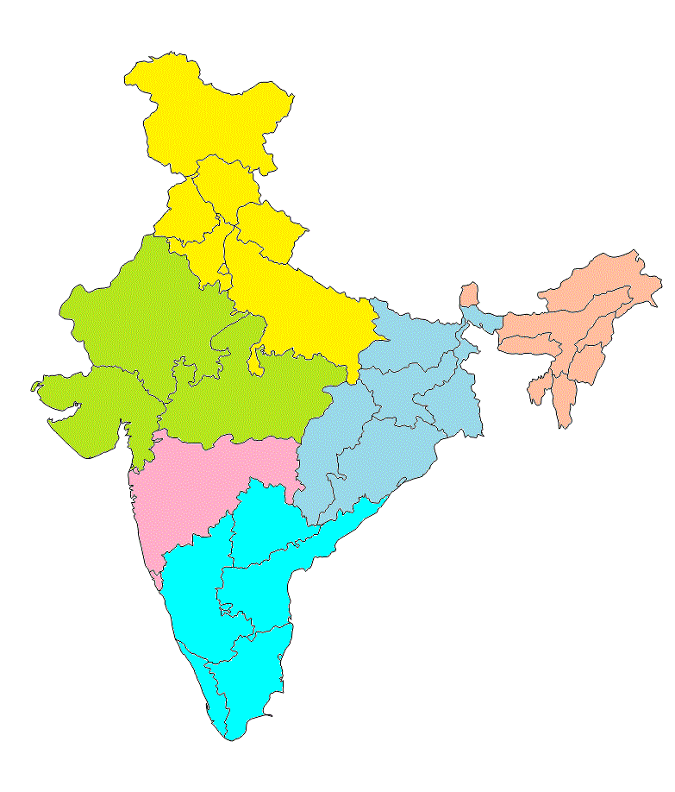


Membership
AUM (Rs.):
>2,50,000 CR
State / UT
Jammu &
Kashmir (3)
(#) No. of members
Himachal
Pradesh
(27)
State/UT: 29
Cities: 334
Punjab (195)
Chandigarh (40)
Uttarakhand
(1)
Haryana (66)
Arunachal
Pradesh
Delhi (66)
Sikkim (1)
Rajasthan
(66)
Uttar Pradesh
(77)
Assam
(64)
Nagaland
(1)
Bihar
(6)
Meghalaya
(9)
Manipur
(1)
No. of Members:
3,105
Gujarat
(358)
Jharkhand
(38)
West
Bengal
(120)
Tripura
Mizoram
Madhya Pradesh
(85)
Chhattisgarh
(8)
Odisha
(9)
Trustee : 6
Patron : 2
Associate : 5
Founder : 153
Life : 148
General : 2371
Members of Association : 420
Maharashtra
(1,132)
Zone | #
North | 487
Central | 482
West | 1207
South | 673
East | 181
North-East | 75
Telangana
(27)
Goa
(55)
Andhra
Pradesh
(160)
Karnataka
(57)
Kerala
(26)
Tamil Nadu
(396)
Pondicherry (6)
UAE 1

Slide 5
FIFA’s Successful Journey so far
Particulars |  | March | December | December
 |  | 2012 | 2018 | 2022
Industry AUM | Rs. in Cr | 5,87,217 | 22,85,912 | 39,88,735
FIFA Membership | No. of | 200 | >2,000 | 3,105
FIFA Members AUM | Rs. in Cr | 10,000 | >1,50,000 | > 2,50,000*
*Approximate

Slide 6
Snapshot of Industry Growth – Over 10 Years
*AUM in Trillion (TN)
FROM |  | TO |  | %
YEAR | AUM | YEAR | AUM | CAGR
2012 | 7.60 | 2017 | 16.46 | 16.7
2017 | 16.46 | 2022 | 39.89 | 19.4
AUM grew by 32.29 TN in 10 years
An annualized Growth rate of 18% per annum over 10 years

Slide 7
Contributors of AUM Growth
2012 - 2022
Rs. in Crore
32,28,740
50%
50%
Growth in AUM

Slide 8
5 Years Growth in AUM
9%
3%
15%
18%
19%
25%
30%
21%
17%
46%
81%
18%
Rs. In Crore

Slide 9
Growth driven by Equity
Asset type | December-2014 |  | December-2022
 | TN | % | TN | %
Equity | 3.44 | 33% | 20.23 | 51%
Debt | 6.91 | 66% | 12.65 | 32%
Others | 0.17 | 2% | 7.01 | 1%
Grand Total | 10.51 | 100% | 39.89 | 100%

Slide 10
AUM Growth driven by Retail Investors
*AUM in Crores
Investors Contribution to Industry AUM
Investor Segments | Investor AUM |  | Growth
 | 31-Mar-17 | 31-Dec-22 | Chg %
Retail Individual Investors | 334,890.69 | 1,011,159.00 | 21%
HNI Investors | 508,261.77 | 1,344,157.00 | 18%
Total Individuals Investors | 843,152.46 | 2,355,316.00 | 20%
Corporate Investors | 868,610.00 | 1,583,971.00 | 11%
Bank & Financial Institutions | 31,772.85 | 45,062.00 | 6%
FIIs | 13,560.74 | 4,387.00 | -18%
TOTAL | 1,757,096.05 | 3,988,736.00 | 15%

Slide 11
Growth driven by Individuals
Investor type | December-2014 |  | December-2022
 | TN | % | TN | %
Retail | 2.32 | 22% | 10.11 | 25%
HNI | 2.93 | 28% | 13.44 | 34%
Total Individual | 5.25 | 50% | 23.55 | 59%
Corporate | 5.26 | 50% | 16.33 | 41%
Grand Total | 10.51 | 100% | 39.89 | 100%

Slide 12
Direct vs Regular
*All figures in Trillion (TN)
Investor type | Corporate | % | Individuals | % | Total | %
Direct | 15 | 94% | 3 | 13% | 18 | 45%
Regular | 1 | 6% | 21 | 87% | 22 | 55%
Grand Total | *16 | 100% | *24 | 100% | *40 | 100%
Investor type | Total | %
Direct + ETF | 20 | 50%
Regular Plans | 20 | 50%
Grand Total | *40 | 100%
* Internal Estimate

Slide 13
Distribution Channels

Slide 14
TER Review
REVAMPMING AND RESTRUCTURING

Slide 15
TER Review
Significant Changes have been proposed on the limits for TERs
Shift of Slabs from Scheme level AUM to AMC Level AUM
TER limits for Equity and Debt based on AMC AUM
Change in TER method for Hybrid Funds
Clubbing various additional expenses under regulation 52(6A)

Slide 16
Impact of the Proposals
 | CURRENT |  | PROPOSED
Current AUM | AAUM | EXP RATIO | EXP RATIO
AUM - Impacted | 18.53 | 1.71 | 1.29
AUM - Not Impacted | 21.46 | 0.35 | 0.35
Total - AUM | 39.99 | 0.98 | 0.79

Slide 17
Trend & Impact on TER of Regular Plan
Trend in TER of Regular Plans | Weighted Average TER
Equity Funds | 2018 | 2022 | Proposed
Total TER excluding transaction cost | 2.35 | 1.81 | 1.39
Reduction in TER in bps |  | -0.54 | -0.42
Reduction in % terms |  | -23% | -23%
Debt Funds Excl. Liquid /MM Funds | 2018 | 2022 | Proposed
Total TER excluding transaction cost | 1.29 | 0.97 | 0.57
Reduction in TER in bps |  | -0.32 | -0.40
Reduction in % terms |  | -25% | -41%
TER Slabs / limits revised in 2018. From 2018 to 2022 there has been reduction in Equity funds of 54 bps (-23%) and in case of debt fund 32 bps (- 25%)
The Changes now proposed will further reduce the TER of Equity Funds by 42 bps (-23%) and Debt Funds by 40 bps (-41%)

Slide 18
Impact on Total Expense Amount of Regular Plan
Amounts in Rs. Crores
IMPACT ANALYSIS FOR REGULAR PLAN
 | WEIGHTED AVERAGE |  | Total Expense |  |  | % | TER on Regular Plan
Asset Class | AAUM | Exp Ratio | Current | Proposed | Change | % Change | New | Change | % Change
Equity Oriented Funds | 1,617,630 | 1.81% | 29,322 | 22,530 | -6,792 | -23.16% | 1.39% | -0.42% | -23.32%
Equity Scheme | 1,177,885 | 1.87% | 21,996 | 17,464 | -4,532 | -20.60% | 1.48% | -0.38% | -20.60%
Hybrid Scheme | 410,186 | 1.64% | 6,717 | 4,776 | -1,941 | -28.90% | 1.15% | -0.49% | -29.78%
Solution Oriented Scheme | 29,560 | 2.06% | 609 | 342 | -267 | -43.78% | 1.74% | -0.32% | -15.43%
Debt | 234,837 | 0.97% | 2,278 | 1,333 | -945 | -41.47% | 0.57% | -0.40% | -41.47%
Debt Scheme | 234,837 | 0.97% | 2,278 | 1,333 | -945 | -41.47% | 0.57% | -0.40% | -41.47%
Grand Total | 1,852,467 | 1.71% | 31,600 | 23,863 | -7,737 | -24.48% | 1.29% | -0.42% | -24.48%
The impact of the proposed changes is Rs 7,737 crores.
The existing Profits of the MF Industry is 7,700 crores.
Industry will not be able to absorb such a huge impact.

Slide 19
AUM , Current TER, Proposed TER & Impact

Slide 20
Global Comparison
The key conclusion arising out of the study is that India in 2018 was the third least expensive country for equity mutual funds across the globe.
The current TER of Equity funds at 1.81 % includes a GST component 0.28%. Thus the net fees received are only 1.54%. This would have made the TER charged by Indian MF industry the lowest in the globe for retail investors.

Slide 21
Mutual Fund Penetration
MFs penetration still lags, leaves scope for expansion
Of the 43.34 crore individual PAN card holders, only 8 per cent or about 3.37 crore have invested in mutual fund schemes as of March-end.
India is at penetration level of 15% of GDP and a long way to go to deepen the penetration.
Mutual funds have huge scope to get more people to invest and efforts to add more distributors in rural regions will help spread the reach.

Slide 22
TER Review
OBSERVATIONS ARISING OUT OF INSPECTION

Slide 23
TER Review
Certain observations during the course of inspection related to:
Splitting and Churning of transactions for B30 incentives
Proliferation of NFOs and switches of NFOs
High Brokerage transaction cost as a % of Aum in some exceptional case
Some additional cost towards GST

Slide 24
B-30 Churn & Splitting of Investors portfolio

Slide 25
Transaction Cost - no limit as a % of AUM

Slide 26
Switches in NFOs

Slide 27
Cross Subsidization across schemes
Category of Fund | Total No of Schemes | No of Schemes With -ve MGM Fees | No of Schemes With Zero MGM Fees | Total No of Schemes Cross Subsidised | % of Schemes violating
Passive | 291 | 26 |  | 26 | 8.9%
A-FOF | 55 | 1 | 3 | 4 | 7.3%
CE-Debt | 672 | 9 | 18 | 27 | 4.0%
CE-Equity | 68 | 1 |  | 1 | 1.5%
OE-Equity | 374 | 1 |  | 1 | 0.3%
OE-Debt | 321 | 2 |  | 2 | 0.6%
Total | 1781 | 40 | 21 | 61 | 3.4%

Slide 28
Additional cost incurred towards GST
GST paid on management fees charged to the schemes and AMCs crediting back some amount to the scheme (Additional cost incurred towards GST).

Slide 29
Trend in AUM of Open End & Close Ended Funds
The 2018 numbers are based on the Study of expense ratio done by Foundation of Independent Financial Advisors (FIFA) and 2022 numbers are arrived at by applying the similar methodology to Dec 2022 Quarterly Average AUM and the latest available expense ratios.
Between 2018 and 2022, there is a decline in Weighted Average TER for Equity Funds by 54 bps (-23%) and for Debt Fund 32bps (-31%). There has already been a substantial decrease in TER and the same has been passed on as benefits of economies of scale to the investors over the years.

Slide 30
TER Review
OTHER POINTS FOR DELIBERATION

Slide 31
Count of MFD
Distribution of MFD based on AUM
AUM Range of MFD Rs Crores |  | No of Distributors
Lower | Upper | No | Cum
1000 |  | 48 | 48
500 | 1000 | 100 | 148
300 | 500 | 182 | 330
100 | 300 | 1215 | 1545
50 | 100 | 1911 | 3456
25 | 50 | 4039 | 7495
10 | 25 | 9245 | 16740
1 | 10 | 20101 | 36841
0 | 1 | 72819 | 109660

Slide 32
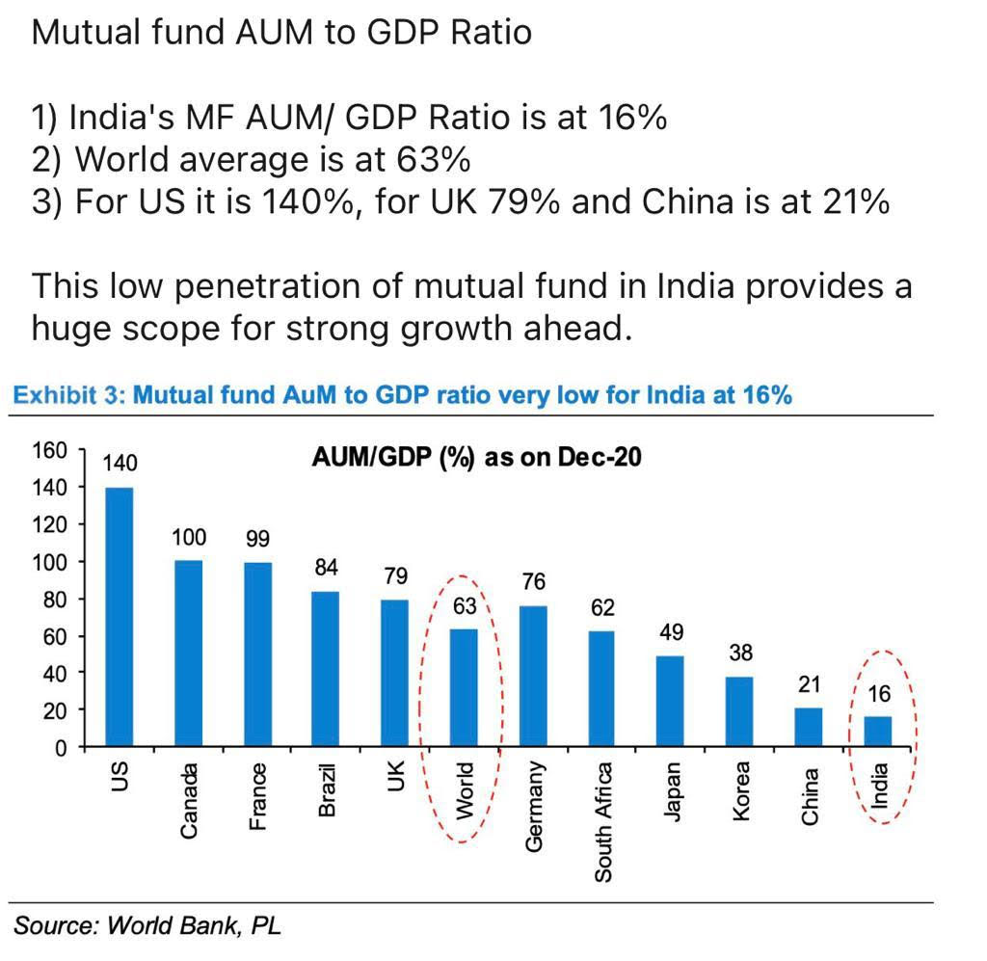
MF AUM to GDP Ratio

Slide 33
Mutual Fund Distributors and AUM

Slide 34
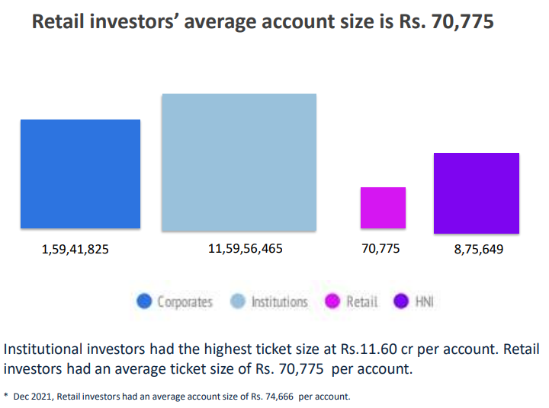
Retail Investor Average Account

Slide 35
AMCs – TOP 10
Top 10 Fund House
Profit ( Rs. Crores )
AMC | FY20 | RANK | FY21 | RANK | FY22 | RANK | IMPACT
SBI MF | 606 | 1 | 863 | 1 | 1071 | 1 | -878
ICICI Pru MF | 1046 | 3 | 1245 | 3 | 1454 | 2 | -981
HDFC MF | 1262 | 2 | 1326 | 2 | 1393 | 3 | -836
ABSL MF | 483 | 4 | 516 | 4 | 660 | 4 | -422
Kotak Mahindra MF | 311 | 6 | 323 | 5 | 380 | 5 | -329
Nipppon India MF | 412 | 5 | 649 | 6 | 711 | 6 | -560
Axis MF | 117 | 8 | 245 | 7 | 402 | 7 | -443
UTI MF | 309 | 7 | 352 | 8 | 418 | 8 | -448
IDFC MF | 80 | 10 | 143 | 9 | 176 | 9 | 4
DSP MF | 116 | 11 | 259 | 10 | 330 | 10 | -194
Total | 4742 |  | 5921 | 0 | 6995 |  | -5,088

Slide 36
AMC – IN RED
IN THE RED
LOSS ( Rs. Crores )
AMC Name | FY20 | RANK | FY21 | RANK | FY22 | RANK | IMPACT
Mahindra Manulife MF | -38 | 24 | -27 | 25 | -38 | 25 | -26
Bank of India MF | -6 | 29 | -8 | 30 | -2 | 30 | -25
Quantum MF | -10 | 32 | -8 | 31 | -7 | 33 | -27
Navi MF | -10 | 33 | -9 | 34 | -21 | 35 | 1
Total | -64 |  | -52 |  | -68 |  | -78
Grand Total | 4678 |  | 5869 |  | 6927 |  | -5165

Slide 37
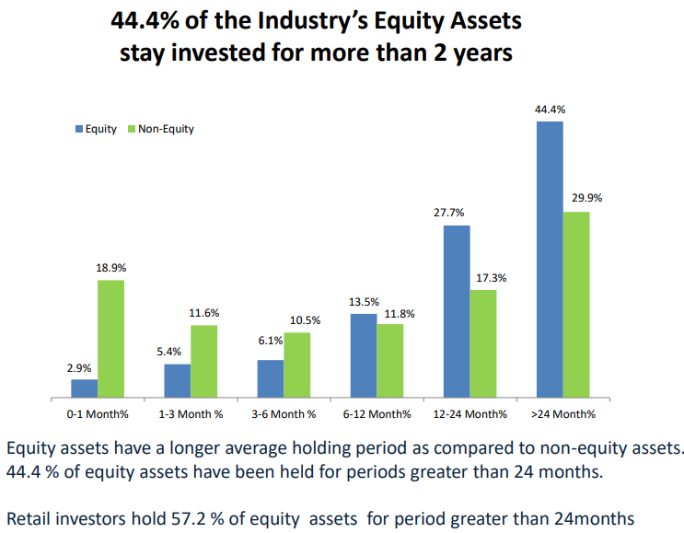
Folio and Ticket Size December 2022

Slide 38
Vision for 2047
From
To
Years
AUM
CAGR
Years
AUM
2002
1.23
20.01%
2012
7.60
2012
7.60
18.03%
2022
39.89
2047
?
2022
39.89
?
1600
16%
*AUM in Rs. Trillion (TN)

Slide 39


